Slide 1




Linear Data Structures: Stacks and Queues
Static and Dynamic Implementation
Stacks and Queues
SoftUni Team
Technical Trainers
Software University
http://softuni.bg

Slide 2

Table of Contents
Linked List
Nodes
Stacks
Static and Linked Implementation
The Stack<T> Class in .NET Framework
Queues
Circular and Linked Implementation
The Queue<T> Class in .NET Framework

Slide 3
Have a Question?
sli.do #DsAlgo

Slide 4

Linked Lists
Chain of Nodes

Slide 5
Node
Building block of many data structures
A basic Node has a value and a pointer to the next node
Variable stores object address
Node<int> head = new Node(2);
Node<int> next = new Node(5);
head.Next(next);
null
address
next
2
address
next
5

Slide 6
Problem: Node
Create a class Node<T>, that has properties:
T Value
Node<T> Next
public class Node<T>
{
public Node(T value)
{
this.Value = value;
}
public T Value { get; set; }
public Node<T> Next { get; set; }
}

Slide 7
Linked List
Linked Lists are a chain of Nodes
Add and Remove – O(1), if we have a pointer to the location
var list = new LinkedList<int>();
list.add(2);
list.add(5);
null
address
next
2
address
next
5
Next pointer consumes memory
head
next

Slide 8
Linked List – Adding First/Last
Count == 0 → Head = Tail = New Node
Count > 0 →
Set new Head
Save old Head
Save old Tail
Set new Tail
B
A
C
Link
Link
head
tail

Slide 9
Linked List – Removing First/Last
Count == 0 → Do Nothing / Throw Exception
Count == 1 → Head = Tail = null
Count > 1
Save old Head
Set new Head
Set new Tail
Save old Tail
B
A
C
Delete
head
Delete
tail

Slide 10
Lab: Linked List
Create a class LinkedList<T>, that supports:
Count
void AddFirst(T item) – O(1)
void AddLast(T item) – O(1)
T RemoveFirst() – O(1) – Invalid Operation Ex.
T RemoveLast() – O(n) – Invalid Operation Ex.
IEnumerable<T>
Same name, without namespace

Slide 11
Problem: Undo List
Save the history of browser pages. You will receive one of 3 commands:
URL - opens the given page
back - returns the previous page
exit - stops the program
www.softuni.bg
www.judge.softuni.bg
www.kids.softuni.bg
back
back
exit
www.judge.softuni.bg
www.softuni.bg

Slide 12
Solution: Undo List
if (command == "back")
{
if (stack.Count != 0) {
Console.WriteLine(stack.Pop());
}
previous = null;
}
else
{
if (previous != null) {
stack.Push(previous);
}
previous = command;
}

Slide 13

Stacks
Static and Dynamic Implementations

Slide 14
The Stack ADT
LIFO (Last In First Out) structure
Elements inserted (push) at the "top"
Elements removed (pop) from the "top"
push
printf()
pop
primes()
main()
Stack

Slide 15
Static Stack
Static (array-based) implementation
Has limited (fixed) capacity
The current index (top) moves left / right with each pop / push
Usually doubles its size (grows) when the capacity is filled
0 1 2 3 4 5 6 7
S
2 | 18 | 7 | 12
top

Slide 16
Linked Stack
Dynamic (linked / pointer-based) implementation
Each node has 2 fields: value and next
Special pointer keeps the top element
top
2
next
7
next
-4
next
5
next
null

Slide 17

The Stack<T> Class
The Standard Stack Implementation in .NET

Slide 18
The Stack<T> Class in .NET Framework
Implemented using an array
Elements are of the same type T
T can be any type, e.g. Stack<int> / Stack<Customer>
Size is dynamically increased as needed (auto-grow)

Slide 19
Stack<T> Basic Functionality
Push(T) – inserts elements to the stack
Pop() – removes and returns the top element from the stack
Peek() – returns the top element without removing it
Count – returns the number of elements in the stack
stack.Push(5);
int number = stack.Pop();
int number = stack.Peek();
int elementCount = stack.Count;

Slide 20
Stack<T> Basic Functionality (2)
Clear() – removes all elements
Contains(T) – checks whether given element is in the stack
ToArray() – converts the stack to an array
TrimExcess() – trim the capacity to the actual space needed
stack.Clear();
bool isFound = stack.Contains(5);
int[] arr = stack.ToArray();
stack.TrimExcess();

Slide 21
Stack<T> – Example
Using Push(), Pop() and Peek() methods
static void Main()
{
Stack<string> stack = new Stack<string>();
stack.Push("1. Ivan");
stack.Push("2. Nikolay");
stack.Push("3. Maria");
Console.WriteLine("Top = {0}", stack.Peek());
while (stack.Count > 0)
{
string personName = stack.Pop();
Console.WriteLine(personName);
}
}

Slide 22
Problem: Matching Brackets
We are given an arithmetical expression with brackets (with nesting)
Goal: extract all sub-expressions in brackets
1 + (2 - (2 + 3) * 4 / (3 + 1)) * 5
(2 + 3)
(3 + 1)
(2 - (2 + 3) * 4 / (3 + 1))

Slide 23
Solution: Matching Brackets
for (int index = 0; index < expression.Length; index++)
{
char ch = expression[index];
if (ch == '(')
stack.Push(index);
else if (ch == ')')
{
int startIndex = stack.Pop();
int length = index - startIndex + 1;
string contents = expression.Substring(startIndex, length);
Console.WriteLine(contents);
}
}

Slide 24

Queues
Static and Dynamic Implementations

Slide 25
The Queue ADT
FIFO (First In First Out) structure
Elements inserted at the tail (enqueue)
Elements removed from the head (dequeue)
enqueue
Client 3
Client 2
Client 1
Queue
dequeue

Slide 26
Linked Queue
Dynamic (pointer-based) implementation
Each node has 2 fields: value and next
Dynamically create and delete objects
head
tail
2
next
7
next
4
next
5
next
null

Slide 27
Static (Circular) Queue
Static (array-based) implementation
Implemented as a "circular array"
Has limited (fixed) capacity (doubled when filled)
Has head and tail indices, pointing to the head and the tail of the circular queue
0 1 2 3 4 5 6 7
Q
 |  | 7 | 12 | 2 | 5
head
tail

Slide 28
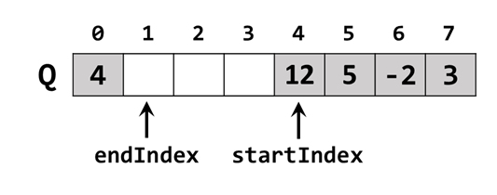
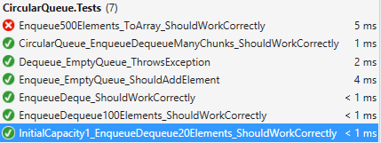
Lab Exercise
Implement a Circular Queue

Slide 29
The Queue<T> Class
Standard Queue Implementation in .NET

Slide 30
The Queue<T> Class in .NET
Queue<T> implements the queue data structure using a circular resizable array
Elements are of the same type T
T can be any type, e.g. / Queue<int> / Queue<DateTime>
Size is dynamically increased as needed

Slide 31
Queue<T> Basic Functionality
Enqueue(T) – appends an element to the end of the queue
Dequeue() – removes and returns the head element
Peek() – returns the head element without removing it
Other methods similar to the Stack<T> methods e.g. ToArray(), Contains(), etc.…
queue.Enqueue(5);
int number = queue.Dequeue();
int number = queue.Peek();

Slide 32
Queue<T> – Example
Using Enqueue() and Dequeue() methods
static void Main()
{
Queue<string> queue = new Queue<string>();
queue.Enqueue("Message One");
queue.Enqueue("Message Two");
queue.Enqueue("Message Three");
while (queue.Count > 0)
{
string message = queue.Dequeue();
Console.WriteLine(message);
}
}

Slide 33
Sequence N, N+1, 2*N
We are given the following sequence:
S = N, N+1, 2*N, N+2, 2*(N+1), 2*N+1, 4*N, …
Find the first index (starting from 1) of given number P
S = 3, 4, 6, 5, 8, 7, 12, 6, 10, 9, 16, 8, 14, …
+1
+1
+1
*2
*2
*2
3 16
11
7 27
258
0 15
138

Slide 34
Sequence – Solution with a Queue
int n = 3, p = 16;
Queue<int> queue = new Queue<int>();
queue.Enqueue(n);
int index = 0;
while (queue.Count > 0)
{
int current = queue.Dequeue();
index++;
if (current == p) {
Console.WriteLine("Index = {0}", index);
break;
}
queue.Enqueue(current + 1);
queue.Enqueue(2 * current);
}
Unfinished: this code will crash in case p is unreachable.

Slide 35
Stack / Queue – Real-World Applications
Stack
Undo operations
Browser history
Chess game progress
Math expression evaluation
Implementation of function (method) calls
Tree-like structures traversal (DFS algorithm)
Queue
Operation system process scheduling
Resource sharing, e.g.:
Printer document queue
Server requests queue
Tree-like structures traversal (BFS algorithm)

Slide 36
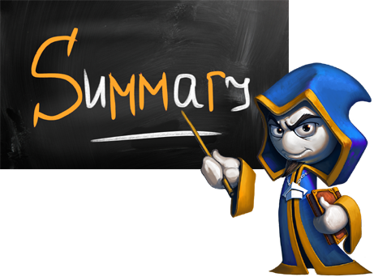
Summary
Stack is LIFO structure (Last In First Out)
Linked implementation is pointer-based
Stack<T> – array-based implementation
Auto-grows when its capacity is filled
Queue is FIFO (First In First Out) structure
Linked implementation is pointer-based
Queue<T> – array-based implementation (circular queue)
Auto-grows when its capacity is filled

Slide 37







Linear Data Structures: Stacks and Queues
https://softuni.bg/opencourses/data-structures

Slide 38
License
This course (slides, examples, labs, videos, homework, etc.) is licensed under the "Creative Commons Attribution-NonCommercial-ShareAlike 4.0 International" license
Attribution: this work may contain portions from
"Fundamentals of Computer Programming with C#" book by Svetlin Nakov & Co. under CC-BY-SA license
"Data Structures and Algorithms" course by Telerik Academy under CC-BY-NC-SA license

Slide 39






Free Trainings @ Software University
Software University Foundation – softuni.org
Software University – High-Quality Education, Profession and Job for Software Developers
softuni.bg
Software University @ Facebook
facebook.com/SoftwareUniversity
Software University @ YouTube
youtube.com/SoftwareUniversity
Software University Forums – forum.softuni.bg

